Slide 1

Controlled Possession:
Playing from Central Midfield into our 9 in the attacking 3rd.
SESSION PLAN
PRESENTATION

Slide 2
Football Problem
When we have controlled ball in central midfield we are missing opportunities to play forward into our 9.
Either through poor positioning/awareness by 6/8/10 not facing/playing forward, or by 9 not anticipating or seeing chance to move into space to receive ball.

Slide 3
Objectives of the Session
To improve the ability of 6/8/10 to combine and create space/time to play into 9.
For 9 to improve awareness and always be available for passing option into the attacking 3rd.

Slide 4
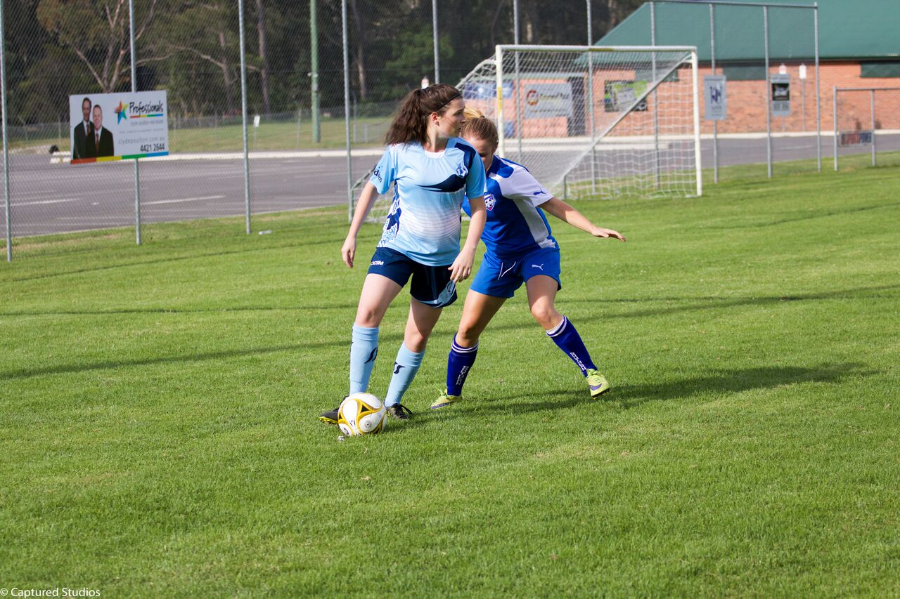
Positioning
Can I get into a position where I can receive the ball?
Away from my opponent
In between defenders
In between the defensive lines
Where I can see & play forward
Where I can run with the ball
Where I can shoot

Slide 5
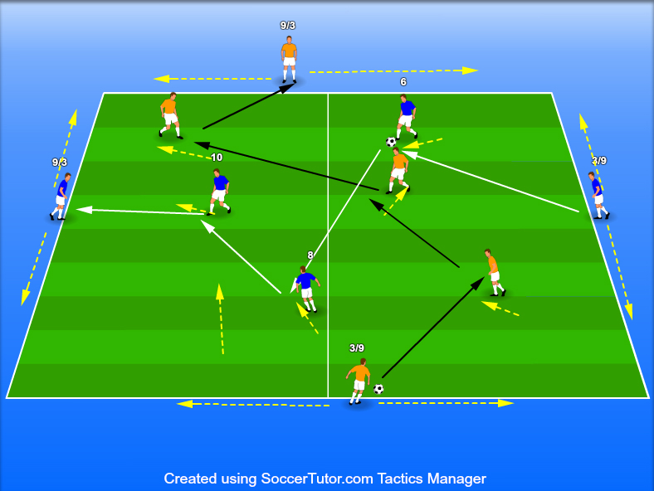
Passing Practice
30m x 30m square, 2 teams of 5 players each.
One team passes N<>South other team E<>West, both teams have 6/8/10 in middle and bouncer 3/9 at either end.
Both teams have a ball and pass off each midfielder as ball goes end to end.
Player cues, coaching on the run without stopping play.
keep ball moving – avoid other team and their ball- keep shape- play forward-
Progress to 2 touch then 1 touch. Add 2nd ball to each team if able.
Rotate end players every 2 minutes.
Progress to Positioning game by only having 1 ball one team BP other team BPO.

Slide 6
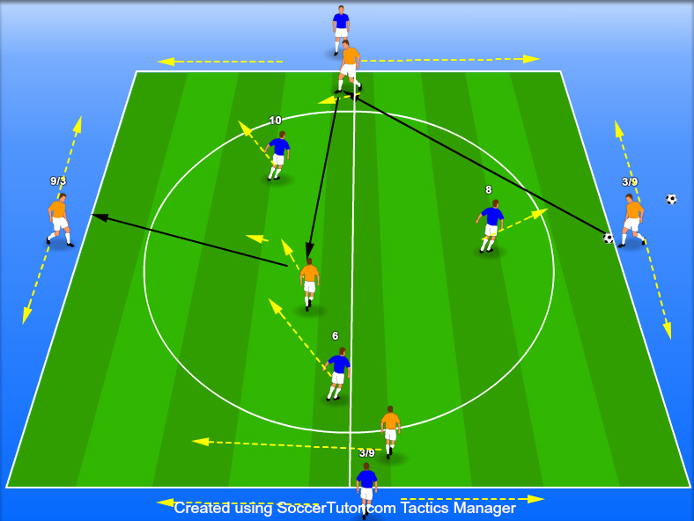
Positioning Game
Progress to Positioning Game from Passing Practice by taking away a ball. Start with unlimited touch then progress 2 touch > 1 touch. Ball on deck.
Team Tasks-
Ball in Possession- BP team must now keep ball and play through to their end and then go back other way. Score a point if they go from one side to the other without losing ball.
Ball in Possession of Opponent- BPO team must prevent BP team playing through to their end & win the ball. Now try & keep ball & score going end to end.

Slide 7
Positioning Game
BP Player Tasks
-6/8/10 providing end players with options high and low, left and right
-making field big as possible.
-End player to able to play forward to players front foot as much as possible.
-Players quickly moving into free space after playing in team mate
-can you open up space for direct pass from 3 to 9 - a killer pass.
-target man 9 sliding to be available
- go home and restart or go other way if blocked off-
-Travel forward with the ball & after drawing a defender and make combination play such as wall pass.
BPO Player tasks
– screen ball into target man 9 & block direct pass
– show them one way & try to lock them into that side using sideline as extra defender.

Slide 8
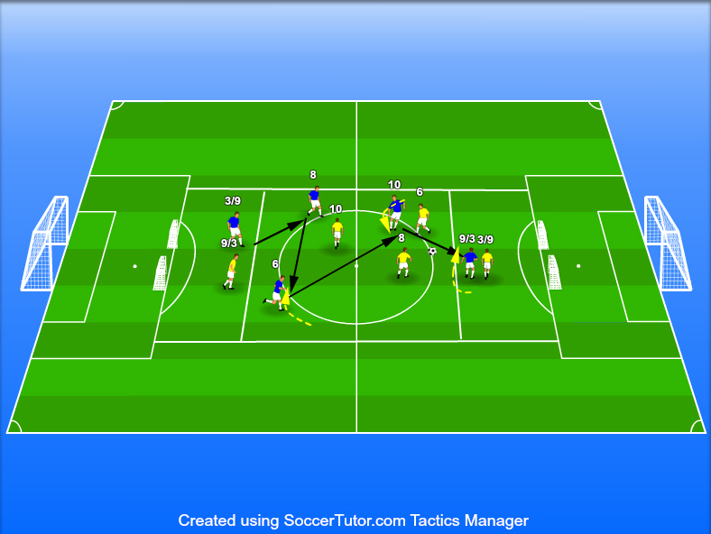
Game Training
The playing setup area same with both teams now playing along length of pitch & we add 10-15m scoring zone on at each end. Position 2 small goals/popups each in line with outside post of main goals. No high long balls from end to end.
1 player from both teams plays in each end zone as 3 or 9 in a 1v1 situation depending on which direction their team is running. Both sets of 6/8/10 play in the central zone.
Teams can play one direction only or Var- can keep ball if they score and try to play back to the starting end
– more incentive for both teams to work harder, quick transition.
Team Task-
BP- Get ball to 9 in end zone with enough space to strike on goal.
[ limit touches or time in end zone so it is realistic & doesn’t get bogged down in 1v1]

Slide 9
BP Player Tasks
-6/8/10 providing No.3 with options high and low, left and right
-making field big as possible.
-our 3 able to play forward passes to players front foot as much as possible.
-6/8/10 quickly moving into free space after playing in team mate
-6/8/10 can you open up space for direct pass from 3 to 9 - a killer pass.
-6/8/10 go home and restart or go other way if blocked off
-6/8/10 travel forward with the ball & after drawing a defender and make combination play such as wall pass.
9 -sliding across zone to be available
9- get into space to score with 1st /2nd touch before you are closed down.
9-bounce ball back to high midfielder then quickly move into space to get ball back and score.
Var- allow BP 3 to travel into mid area to create overload, also creates counter attack option for BPO. Then if 3 travels does 6 or 8 need to screen their 9 to counter the counter attack.
Var- allow one of 6/8/10 to travel into end zone to support 9 & score or assist.

Slide 10
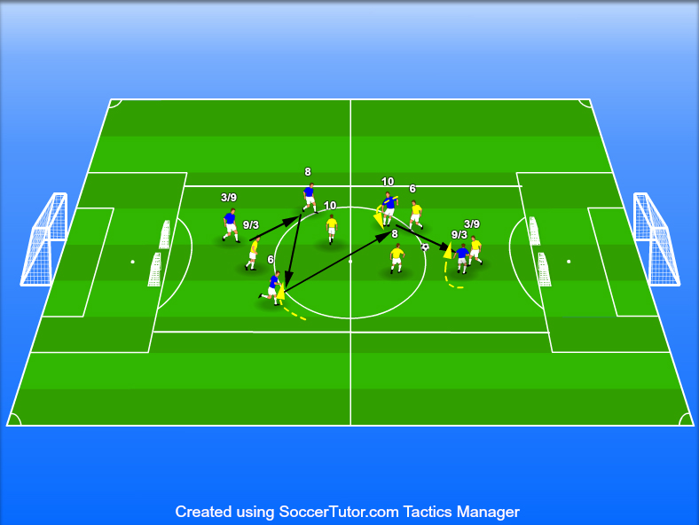
Training Game
Same setup as Game Training but we take away the end zones and allow players to access all areas and any player to score.
Rules – offside applies
Must be in attacking half to score
Var or Conditioning game all attackers must be in attacking half for goal to count
If any defenders in other half goal counts as double

Slide 11
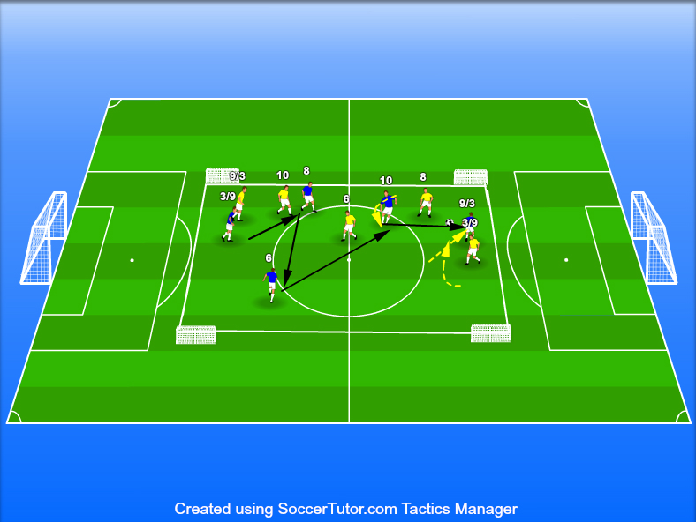
Training Game
Variation Game
Same field but with the 4 small goals swung around so field is now shorter but much wider.
Encourages switching of play and use of width
Improves player vision
Encourages lateral transition in BP and BPO

